Slide 1


Cloud Native Workshop Kubernetes and OpenShift Overview
IBM Hybrid Cloud Ecosystem
Ecosystem Labs

Slide 2

Everyone’s container journey starts with one container….

Slide 3
At first the growth is easy to handle…

Slide 4
But soon you have many apps many instances…
4

Slide 5
And that is why there is container orchestration
5

Slide 6
Project
Overview
Notes:
Quick overview of the project and what Kubernetes it
Note: This is currently for v1.12

Slide 7
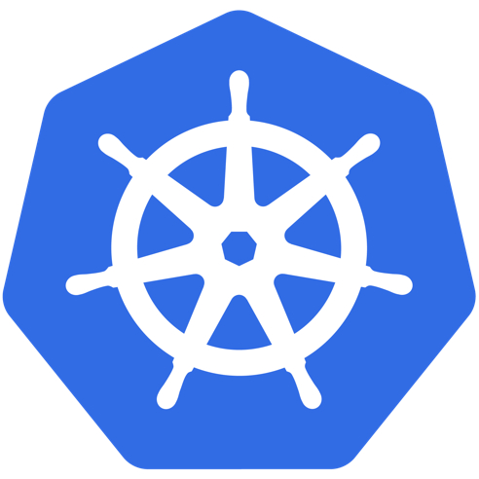

What Does “Kubernetes” Mean?
Greek for “pilot” or
“Helmsman of a ship”
Image Source
Notes:
The first question always asked
There is also the abbreviation of K8s -- K, eight letters, s

Slide 8
What is Kubernetes?
Project that was spun out of Google as an open source container orchestration platform.
Built from the lessons learned in the experiences of developing and running Google’s Borg and Omega.
Designed from the ground-up as a loosely coupled collection of components centered around deploying, maintaining and scaling workloads.
Notes:
There’s a phrase called Google-scale. This was developed out of a need to scale large container applications across Google-scale infrastructure
borg is the man behind the curtain managing everything in google
Kubernetes is loosely coupled, meaning that all the components have little knowledge of each other and function independently.
This makes them easy to replace and integrate with a wide variety of systems

Slide 9
What Does Kubernetes do?
Known as the linux kernel of distributed systems.
Abstracts away the underlying hardware of the nodes and provides a uniform interface for workloads to be both deployed and consume the shared pool of resources.
Works as an engine for resolving state by converging actual and the desired state of the system.
Notes:
linux kernel of distributed systems
Sort of like a hypervisors, in that it abstracts away the underlying host resources and shares them in a normalized way.
the underlying substrate or platform to build your applications and tools on top of
Think of Kubernetes like a higher-level language for your application architecture.
you describe what you need and it tries to resolve it
with that in mind, it acts as an engine to resolve state using the abstracted resources to deploy and manage your application.
It is declarative, and not imperative. You tell it or “declare” what you want, and it figures out the rest.
imperative you tell something every step you want it to do
declarative you tell it what you want it to be, and it figures it out
e.g. ‘I want 5 instances of x’ and it just does it, if something dies, it brings it back to get to 5

Slide 10
What can Kubernetes do?
Autoscale Workloads
Blue/Green Deployments
Fire off jobs and scheduled cronjobs
Manage Stateless and Stateful Applications
Provide native methods of service discovery
Easily integrate and support 3rd party apps
Notes:
Everything here requires some level of configuration

Slide 11

Most Importantly...
Use the SAME API across bare metal and EVERY cloud provider!!!
Notes:
Single biggest value-add Kubernetes can offer

Slide 12
A Couple
Key Concepts...
Notes:
There are a few small things we should mention
It’s kind of a chicken and egg problem. But we need to talk about these before the stuff that supports and extends it

Slide 13
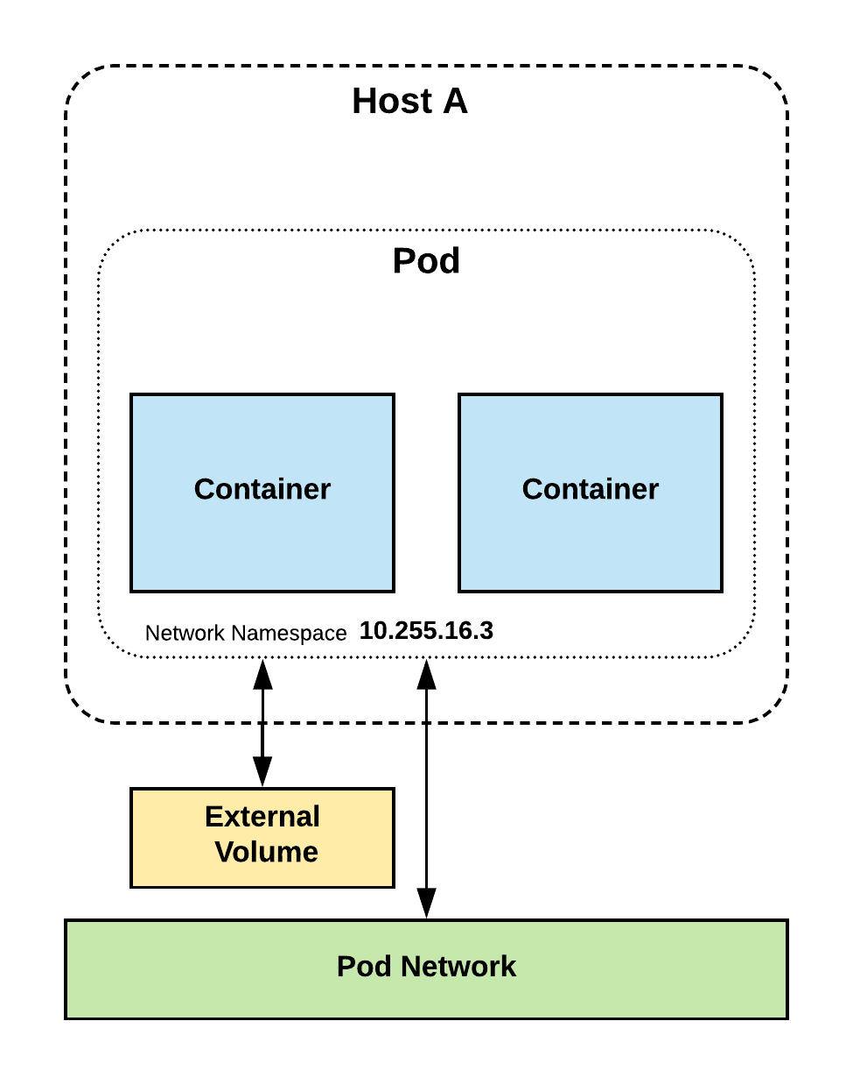
Pods
Atomic unit or smallest “unit of work”of Kubernetes.
Pods are one or MORE containers that share volumes, a network namespace, and are a part of a single context.

Slide 14
Pods
They are
also
Ephemeral!
Notes:
Higher level objects manage replicas, fault tolerance etc.

Slide 15
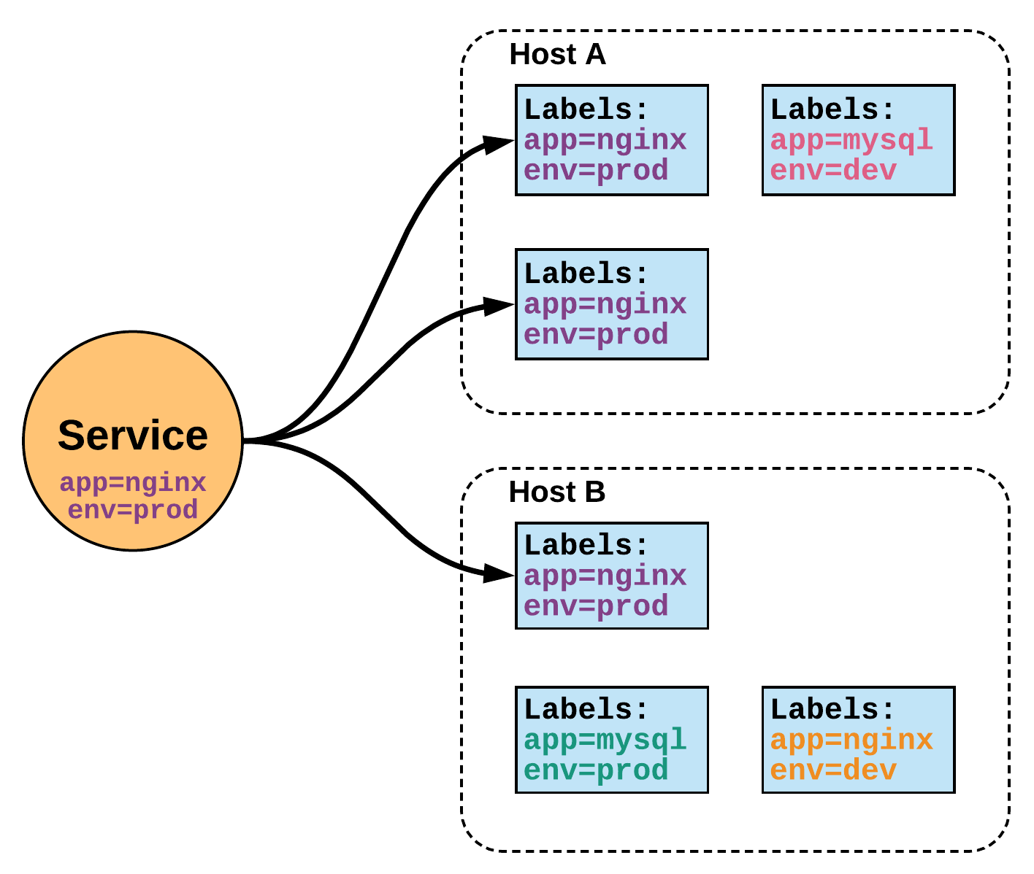
Services
Unified method of accessing the exposed workloads of Pods.
Durable resource
static cluster IP
static namespaced DNS name
Notes:
While this may seem like a technical definition, in practice it can be viewed more simply:
A service is an internal load balancer to your pod(s). You have 3 HTTP pods scheduled? Create a service, reference the pods, and (internally) it will load balance across the three.

Slide 16
Services
Unified method of accessing the exposed workloads of Pods.
Durable resource
static cluster IP
static namespaced DNS name
NOT Ephemeral!
Notes:
Services are persistent objects used to reference ephemeral resources

Slide 17


Trusted enterprise Kubernetes
A cloud-like experience, everywhere
Hybrid, Multi-Cluster Management
Operator Framework
Operator Hub & Certified ISVs
Empowering developers to innovate
OpenShift Service Mesh (Istio)
OpenShift Serverless (Knative)
CodeReady Workspaces (Che)
Notes:
We have spent the past 4+ years building the Kubernetes platform upstream and making it trusted, secure & enterprise ready for customers in OpenShift 3.
In OpenShift 4, we’re putting more focus on how you install, upgrade and manage the platform day 2.
This based on feedback from OpenShift customers and the Kubernetes user community on the biggest challenges they face
Let’s first focus on how OpenShift is the Trusted enterprise Kubernetes platform.

Slide 18

TRUSTED HOST, CONTENT, PLATFORM
CONTAINER
TRUSTED CONTENT
Red Hat provides up-to-date base container images and validated content from dozens of ISV partners
APP
RUNTIME
TRUSTED PLATFORM
OpenShift extends Kubernetes with built-in authentication and authorization, secrets management, auditing, logging, and container registry for granular, centralized control
OS
(USER SPACE)
KUBERNETES
TRUSTED HOST
OpenShift runs on Red Hat Enterprise Linux, the most deployed commercial operating system in the public cloud, trusted by more than 90% of the Fortune 500
HOST OS
Notes:
An important thing to remember is that containers are based on Linux and the capabilities that Linux enables. OpenShift builds from Red Hat Enterprise Linux with the RHEL CoreOS instance on the master nodes. When determining what the OpenShift product contains, a number of additional key opensource projects have been bundled along with Kubernetes to enable additional security features for container orchestration. And Red Hat works with dozens of ISV partners to provide base images for software in the containers used by OpenShift customers.

Slide 19
Trusted enterprise Kubernetes
A cloud-like experience, everywhere
Hybrid, Multi-Cluster Management
Operator Framework
Operator Hub & Certified ISVs
Empowering developers to innovate
OpenShift Service Mesh (Istio)
OpenShift Serverless (Knative)
CodeReady Workspaces (Che)
Notes:
OpenShift 4 will also help us strengthen our hybrid cloud positioning, bringing the simplicity of the cloud everywhere

Slide 20
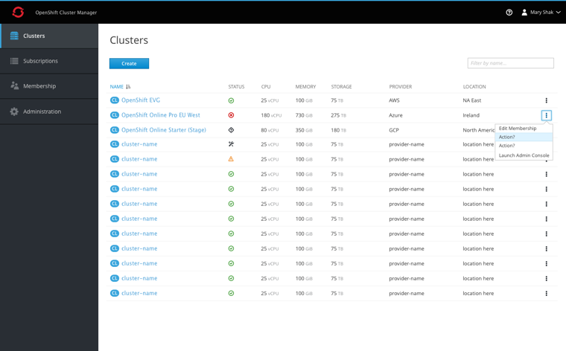
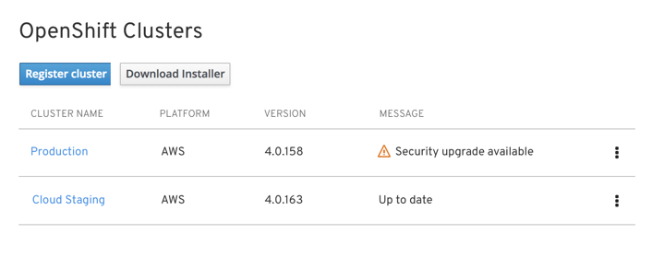

Delivering Kubernetes everywhere
Manage multiple OpenShift clusters, across multiple cloud and on-premise environments
Install and update OpenShift across all your cloud environments
Centrally manage policy and deployments
cloud.redhat.com
Notes:
To help you manage many different OpenShift clusters we’re now also offering a SaaS-based management console that allows you to register existing OpenShift clusters and provision new ones so you can get comprehensive visibility across all your clusters
Simply log on to cloud.redhat.com and you’re good to go.

Slide 21





Kubernetes Operators - Automate day 2 management
Flexible app architectures
No reinvention
of core concepts
Uniform deploy
and debug
Truly hybrid
Operators codify operational knowledge and workflows to automate life-cycle management of containerized applications with Kubernetes
Notes:
Kubernetes Operators automate day 2 management tasks. Kubernetes Operators are essentially “software-defined IT admins” or in other words, encoded workflows and routines that are part of a containerized application, or any other component that is delivered as a container and running on Kubernetes.
Because you’re translating best practices into Kubernetes concepts, you’re not reinventing the wheel and you end up with a truly hybrid application. Operators function the same no matter where they are running.
The Operator Framework is a set of tools that helps you build and run Operators on a Kubernetes cluster, including an SDK to get you up and running quickly.

Slide 22








Cloud database
Containerized
Containerized
Cloud storage ready
Replicated
Backup
Automated updates
Containerized
Container storage ready
Replicated
Backup
Automated updates
Enhanced observability
Customization
Local development
Fully open source
Any Kubernetes
Certified on OpenShift
Operators enable a cloud-like experience everywhere you run Kubernetes
Notes:
Let’s look at a real example. Compare running Postgres in a container, using a cloud service, or using the CrunchyData Operator.
As you can see, the Operator gives you a SaaS-like experience, with the added benefit of using an open source stack that can be run locally, and allows you to observe its components.
Or think of a data service you can sign up for at AWS, like RDS. AWS does not need to hire a new DBA every time a customer signs up for that service. They’ve built a lot of automation into RDS to back up, sync or rebalance the data service if needed. And Operators give you that same functionality but for every application and the OpenShift platform itself everywhere you run Kubernetes.
That is very powerful and a tremendous benefit to help manage stateful applications at scale.

Slide 23
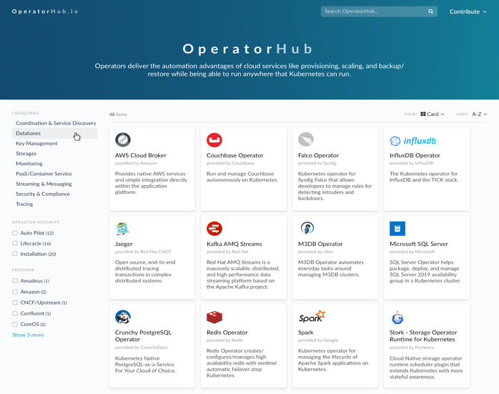
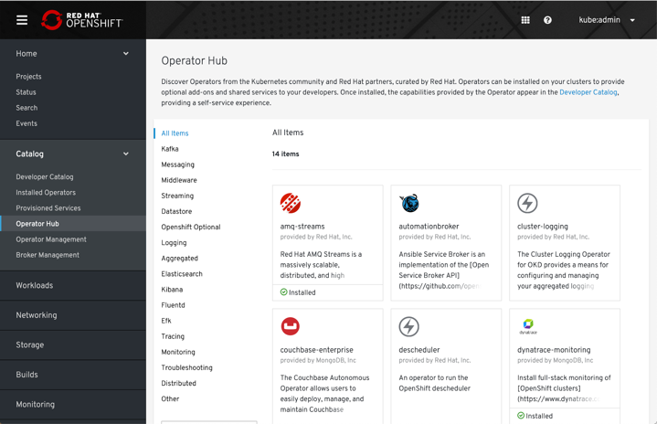
Operator Hub and Certified Operators
OperatorHub.io launched by Red Hat, AWS, Microsoft, and Google
OpenShift Operator Certification
Operator Hub integrated into OpenShift 4
COMMUNITY OPERATORS
OPENSHIFT CERTIFIED OPERATORS
Notes:
So how do you get these operators?
The Operator Hub was launched by Red Hat and our launch partners AWS, Microsoft and Google earlier this year. It provides a single place on the internet for developers to publish operators and for customers to find and consume curated operators. These operators meet certain quality standards so you can have the confidence they deliver what they promise. You can deploy these operators on any Kubernetes distribution, not just OpenShift.
But we’ve also integrated the OperatorHub into OpenShift where you can also find fully certified operators from our partners that meet a very high bar of quality standards.

Slide 24
Trusted enterprise Kubernetes
A cloud-like experience, everywhere
Hybrid, Multi-Cluster Management
Operator Framework
Operator Hub & Certified ISVs
Empowering developers to innovate
OpenShift Service Mesh (Istio)
OpenShift Serverless (Knative)
CodeReady Workspaces (Che)
Notes:
Ultimately OpenShift is about empowering developers and we have a number of great new developer services coming to OpenShift 4

Slide 25







OpenShift enables developer productivity
BUILD
TEST
DEPLOY
Self-service provisioning
Consistent
environments
Automated
build & deploy
CI/CD pipelines
Configuration management
App logs & metrics
CODE
REVIEW
MONITOR
SPRING & JAVA™ EE
MICROSERVICES
FUNCTIONS
LANGUAGES
DATABASES
APPLICATION SERVICES
LINUX
WINDOWS*
* coming soon
Notes:
No matter what architecture you choose for your applications, what programming language the developers find most useful and what services you want to use as building blocks, OpenShift provides a single and consistent development model across the build, test, deploy, monitor, and review lifecycle of the application.
Self-service infrastructure: let’s developers provision what they need on-demand and skip waiting for hours, days and sometimes weeks for infrastructure resources
Consistent environments: OpenShift makes sure the environment provisioned for developers and across the lifecycle of the application is consistent from the operating system, to libraries, runtime version (e.g. Java runtime) and even the application runtime in use (e.g. tomcat) in order to remove the risks originated from inconsistent environments
Automated build and deployment: OpenShift gives a choice to developers, to build their containerized applications themselves or to have the platform build containers from the application source code or even binaries. The platform then automated deployment of these applications across the infrastructure based on the characteristic that the team has defined for the apps such as how much resources should get allocated and where on the infrastructure they should get deployed to be compliant with third-party licenses.
Continuous delivery pipelines: OpenShift provides out-of-the-box support for CI/CD pipelines so that development teams can automated every step of the application delivery process and make sure it’s executed on every change that is made to the code or configuration of the application
Configuration management: configuration and sensitive data management is built-in in the platform to ensure consistent and environment agnostic application configuration is provided to the application no matter what technologies is used to build the application and which environment it is deployed. Application logs & metrics: rapid feedback is an important aspect of application development. OpenShift integrated monitoring and log management provides immediate metrics back to developers in order for them to study how the application is behaving across changes and be able to fix issues as early as possible in the application lifecycle.

Slide 26







Building next-gen applications
OpenShift Service Mesh
Provides security and network segmentation for microservices applications.
Combines Istio, Kiali (UI), and Jaeger (tracing) projects.
OpenShift Serverless
Enabling scale-to-zero functions and event sources, built on the Knative framework.
Supports Azure Functions
Integrated with Apache Camel K for rich set of initial event sources: HTTP, Kafka, AMQP
OPENSHIFT
SERVERLESS
OPENSHIFT
SERVICE MESH
Notes:
As we discussed before, OpenShift supports a very broad range of application types and frameworks.
Service Mesh and Serverless are exciting technologies that make it easier to build and run microservices architectures and we support both in OpenShift 4.
Service Mesh provides networking capabilities at the application layer so that application components can discover services and communicate with one another. OpenShift also supports monitoring and tracing of inter-application network traffic using Kiali, Jaeger and Istio framework underneath.
Serverless is less mature at this stage and we have announced support for a number of event sources on the knative framework including Azure Functions, OpenWhisk and Camel K.

Slide 27




Enabling greater developer productivity
CodeReady Workspaces
Based on Eclipse Che, collaborative development, integrated with CI/CD
OpenShift plug-ins
Integration plug-ins for VS Code, Azure DevOps, Eclipse IDE, JetBrains
OpenShift ODO
Advanced developer CLI
CODEREADY
WORKSPACES
ODO
DEV
VS CODE
AZURE DEVOPS
ECLIPSE
JETBRAINS
Notes:
In terms of developer tools, CodeReady Workspaces provides an Eclipse Che-based developer IDE that is tightly integrated with OpenShift. CodeReady Workspaces provides support for development teams to build applications together.
But even if you’re using Visual Studio Code, Intelli-J or any other IDE, OpenShift plug ins allow you to use your existing tools yet deploy your apps on OpenShift.
And for command line users, odo gives you a very powerful CLI to deploy applications on the command line.

Slide 28
















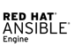



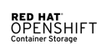




THE POWER OF THE OPENSHIFT ECOSYSTEM
RED HAT PORTFOLIO Optimized for Containers
THIRD-PARTY ISV
Red Hat Container Catalog (100s certified)
CLOUD SERVICES Open Service Broker
RED HAT ENTERPRISE LINUX ECOSYSTEM Hardware, Virtualization, Cloud and Service Provider Certifications
Notes:
The power of OpenShift is not only in its own capabilities but also in the broad ecosystem of products, vendors, cloud providers and partners that enrich the platform with complimentary services.
Red Hat portfolio: Red Hat portfolio of middleware services like application platform, integration and messaging, business rules, etc provides a set of well-integrated building blocks for application developers to build new application faster or migrate their existing applications that use these technology to OpenShift and become more agile. Red Hat Quay Registry is an enterprise registry that adds a complete container image lifecycle management solution to the OpenShift platform.
Third-party ISVs: OpenShift recognizes that organizations have standardized on different vendors for storage, network, application services, monitoring, etc and therefore has a vibrant partner community with 200+ certified software vendors so that customers can take advantage of the wide array of offering from these partners for their applications on OpenShift.
Cloud services: OpenShift service broker enables organizations to integrate and expose public cloud services from Amazon, Microsoft, Google, etc to their developers on OpenShift and allow them to provide a native OpenShift experience for building applications using these cloud services all within OpenShift.
RHEL ecosystem: OpenShift is powered by Red Hat Enterprise Linux technologies and takes advantage of the rich ecosystem of certified hardware, virtualization, cloud and service providers for Red Hat Enterprise Linux which allows OpenShift to run reliably on any infrastructure.

Slide 29
Questions?

